Slide 1


Rocking Tech. Co. Inc
Introduction to PQR Capital Advisors
Dec 29, 2024
by Yana Mir

Slide 2
Table of Contents
Section I Client Overview- - - - - - - - - - - - - - 03
Section II Client Objective- - - - - -- - - - - - - - - 16
Section III Transaction Options - - - - - - - - - - - 18
Section IV PQR Overview- - - - - - - - - - - - - - - - 20
Section V Recommendation- - - - - - - - - - - - - - 28

Slide 3

SECTION 1
Introduction to Rocking
Tech Inc.
Leading E-commerce solutions provider
Dedicated to revolutionizing online retail.
Focus on Innovation and Customer Success
Delivers cutting-edge solutions that drive growth and efficiency for businesses worldwide
3

Slide 4

E-commerce Sector Expertise
Deep Understanding
Industry Insights
Strategic Partnerships
The company first leverages its expertise to provide tailored solutions that address the specific needs of each client, Then based on these models, develops solutions for universal commercial use.
Rocking Tech has a deep understanding of the evolving e-commerce landscape and the unique challenges faced by online retailers. It is usually first to release solutions in the E-commerce market based on this knowledge.
Rocking Tech maintains strong partnerships with industry leaders, ensuring access to the latest technologies and trends.
4

Slide 5
Key Employees and Shareholders
\
5

Slide 6

Some of Rocking Tech’s Path-breaking Innovative Products for Online Retailers :
OmniSend
Cin 7
Listed as 2024’s best E-Comm tool to drive Sales.
First of its kind synchronized automation platform for email, SMS, and web push.
Winner of Digital Sales Award 2022, It’s a tool suite for optimizing inventory management, manufacturing, and purchasing
Qlik
Rocking Tech’s Trophy Solution, an intelligent alerting data analytics and business intelligence platform that supports both cloud and on-premises deployment.
6

Slide 7




Strong Global Customer Base
High Retention Rates
Positive Testimonials
Rocking Tech boasts high customer retention rates, demonstrating its commitment to providing exceptional service and value.
The company has received numerous positive testimonials from satisfied customers, highlighting the impact of its solutions.
Strong Relationships
Rocking Tech fosters strong, long-term relationships with its clients, building trust and mutual success.
7

Slide 8
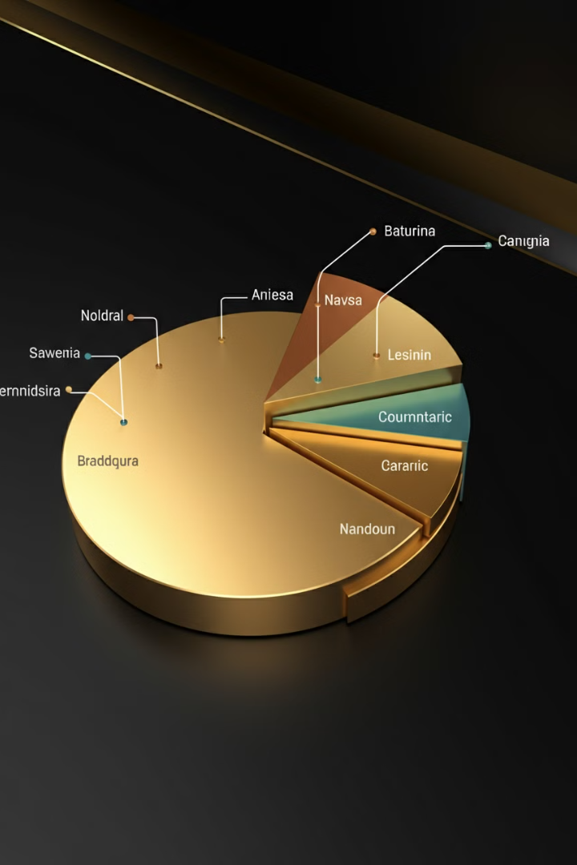
International Market Expansion
1
Rocking Tech has successfully expanded its operations into key international markets, demonstrating its global reach and ambition.
2
The company has established a strong presence in Europe, Asia, and South America, capturing new opportunities and growing its customer base.
3
Rocking Tech continues to explore new markets, aiming to become a truly global leader in the e-commerce solutions space.
8

Slide 9

Financial Highlights: EBITDA Revenue and Growth
$12M
15%
EBITDA Revenue
Annual Growth
In 2024, Rocking Tech generated an impressive EBITDA revenue of $12 million, showcasing its strong financial performance.
The company has consistently grown its revenue at a CAGR of 15% per annum since its inception five years ago.
9

Slide 10
Performance Overview
10

Slide 11
INCOME STATEMENT (HISTORICAL & PROJECTED)
Figures in USD ACTUALS PROJECTIONS
Particulars Dec 2019 Dec 2020 Dec 2021 Dec 2022 Dec 2023 Dec 2024 Dec 2025
Revenue Total Revenue YOY Growth % Cost Of Sales Total Cost of Sales % of Revenue
Gross Income Gross Margin % Operating Expenses Total operating Expenses % of Revenue Net Income From Operations Operating Margin % Other Income & Expenses
Net Income / Loss Net Income Margin %

Slide 12
BALANCE SHEET (HISTORICAL)
Figures in USD
Particulars Dec 2019 Dec 2020 Dec 2021 Dec 2022 Dec 2023
Assets Current assets Total Current Assets Fixed Assets Total Fixed Assets Other Assets Total Other Assets Total Assets Liabilities and Equity Liabilities Current Liabilities Total Current Liabilities Long Term Liabilities Total Long Term Liabilities Total Liabilities Equity Total Equity Total Liabilities And Members’ Equity

Slide 13
EBITDA Details
Figures in USD ACTUAL FORECASTED
Particulars Dec 2020 Dec 2021 Dec 2022 Dec 2023 Dec 2024 Dec 2025
EBITDA EBITDA % Software Expense Hardware Expense Automobile Payment Bad Debt Expense Payroll - Salaries Professional Fees Rent Server Maintenance Data Storage Charges System Upgrade Adjustments Total Equity Total Liabilities And Members’ Equity Adjusted EBITDA Adjusted EBITDA %

Slide 14




COMPETITIVE LANDSCAPE
BUSINESS DESCRIPTION INVENTORY MARKETING CUSTOMER ACCOUNTING DATA INTEGRATION SERVICE ANALYTICS
operates in the e-commerce sector, provides innovative solutions for online retailers offers integrated inventory automation a solutions and a payment gateway Pioneering Developer of Marketing, Customer Service and Data Solutions Leading manufacturer of Marketing,CRM an and Accounting Software Sales Expediting Technology with built-in CRM and Data Functions | ✓ | ✓ | ✓ | ✓ | ✓ | ✓
 | ✓ |  |  | ✓ |  | ✓
 |  | ✓ | ✓ |  | ✓
 |  | ✓ | ✓ | ✓ | ✓
 |  | ✓ |  |  | ✓
Rocking Tech LOGO

Slide 15



Investment Potential
Strong Fundamentals
1
Rocking Tech's solid financial fundamentals and robust growth trajectory make it an attractive investment opportunity.
Market Leadership
The company's position as a leading e-commerce solutions provider provides a significant competitive advantage.
2
Future Growth
Rocking Tech’s yearly renewable contracts with its Corporate Clients, ensure financial stability. Growing global demand for E-commerce solutions, ensures continued innovation. Successful Expansion strategy into new markets, offer significant potential for future growth.
3
15

Slide 16
SECTION 2
OBJECTIVES
Scaling for the future
16

Slide 17
PRIMARY OBJECTIVES
Strategic Financing
1
To Fund global expansion, new markets, and strategic partnerships with key players in the industry.
Market Expansion
2
Expanding our operations to new markets, opening doors to a wider customer base and capturing greater market share.
Customer Retention
3
Investing in cutting-edge technologies to enhance our offerings, delivering a superior user experience and driving innovation.
17

Slide 18
SECTION 3
TRANSACTION
OPTIONS
18

Slide 19
Debt Financing
Ownership Retention
Tax Benefits
Predictable Payments
Repayment Obligation
Increased Financial Risk
Collateral Requirement
Equity Offering
No Repayment Pressure
Access to Expertise
Increased Capital
Dilution of Ownership
Potential Conflicts
Costly Process
Strategic Partnerships
Resource Sharing
Risk Mitigation
Enhanced Market Reach
Shared Control
Alignment Challenges
Dependency Risks
19

Slide 20
SECTION 4
Introduction to PQR Capital Advisors
20

Slide 21

PQR Overview
Industries Served
Investment Banking Services
E-Commerce
Fintech
Underwriting
EdTech
Acquisition advisory
Cloud Services
Debt financing
Block Chain
Valuations
Transaction Focus
Large Corporations
PSUs
Values Over $100M
21

Slide 22




Corporate / PSU Experience
Operating Experience
Team members have held C-suite positions in private companies and been through transactions as management
Financial Expertise
CFO backgrounds allow for granular understanding of small businesses, financials, and addressing issues
22

Slide 23





E-Commerce Relevant Experience
Fashion and Food Retail
Fintech
PQR supports businesses with flexible financing options that can adapt to seasonal fluctuations.
PQR assists fintech companies in securing capital through innovative debt structures that align with their digital-first strategies.
Edtech
Block Chain
PQR provides tailored financing solutions that help edtech companies scale effectively.
PQR offers specialized underwriting services for tokenized assets and blockchain-based financial instruments
23

Slide 24




PQR Professionals
Name Managing Director
Name Vice President
Name Associate
Experience: C-suite experience in operating companies • Combined xx+ years of corporate finance and M&A experience Education: University of Chicago, MBA Vanderbilt Universit
Experience: Cohesive team with long track record of working together to achieve successful client outcomes Education: University of Georgia
Experience : Combined xx+ years of corporate finance, M&A, and valuation experience Education : University of Tennessee
Name Analyst
Experience : Nearly one decade of combined tenure at PQR Education :University of North Carolina
24

Slide 25

Top Tier Clients
Client 1
Description
Client 2
Description
Client 3
Description
Client 4
Description
25

Slide 26

Recently Closed Transactions
Engagement
Location
Type
Text
Text
Underwriter
Text
Text
Underwriter
Text
Text
Sell-side advisory
26

Slide 27




Awards and Testimonials
27

Slide 28

SECTION 4
Recommendations
28

Slide 29
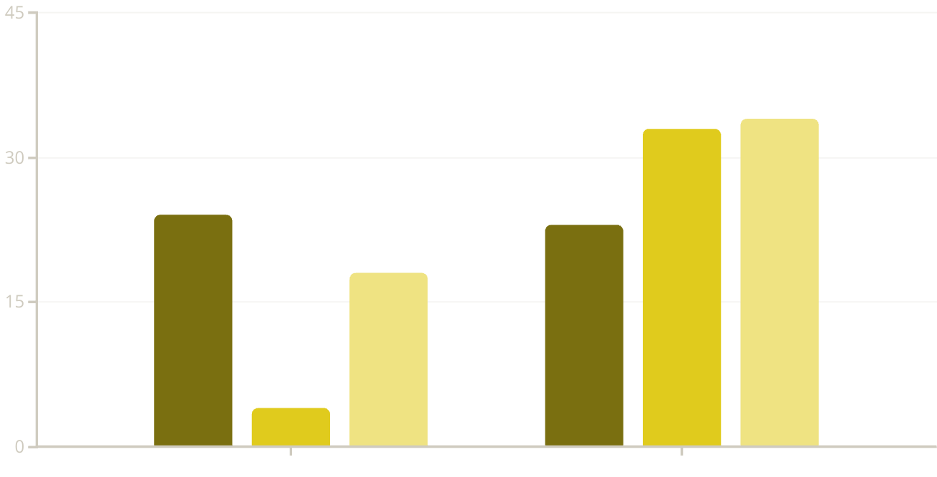
Market Analysis: Current IPO Trends
No. of IPOs launched in recent financial quarters
Q4 2021
Q3 2022
Q4 2022
(BSE and NSE) (SMEs)
29

Slide 30

Lower Middle Market Equity Performance
Trading Volume
Valuation Premium
Very Strong since 2021, due to Covid impacting physical Commercial activities
44% higher valuation for tech companies in Q1 2023
Price to Earnings Ratios
High due to Government support and subsidies for E-Commerce
Technologies, and absence of market overcrowding in the field.
30

Slide 31
M&A and Private Equity Activity
US M&A Activity
1
Cooling from 2021 peak
PE Dry Powder
2
Drying levels of capital to deploy
Valuation Multiples
3
Averaging ~7.5x EBITDA in 2022
31

Slide 32

Market Growth Drivers
Increased Spending
Improved Technology
Rising disposable income and markets recovering from covid impact
Integration of IoT, AI, and smart sensors, making digital spending and investing easier
Tax Benefits
Lower taxes on income from stock investments, attracting
many conservative households as second income option
32

Slide 33

Market Capitalization Overview: E-Commerce
$44.5B
$67.8B
2022 Market Value
2030 Projected Value
15.4%
$44.5B
2022 Traded Value
CAGR
North America holds 44.8% market share, with US launching 58.5% of North American E-Commerce IPO shares.
33

Slide 34




The PQR "Valuation Formula" to fetch you the winning "Price"
Relative
to similar publicly traded companies (peers) in the industry.
Absolute
focus on Your Company's intrinsic value using Discounted Cash Flow (DCF) analysis.
Market Demand Assessment
gauging investor interest through pre-marketing sessions and feedback from institutional investors.
34

Slide 35

Process Overview with Timeline
1
2
3
Development
Marketing
Closing
Drafting the Prospectus
Conduct roadshows
Setting final offering price
Determining Offer Price
Create Buzz in Investor Channels through Targeted Campaigns
Purchasing shares at the offering price and allocating them to investors,
Forming risk-sharing syndicate
Effective PR Strategy to enhance visibility and manage narrative
Monitoring First Day of Trading and transition from private to public ownership
35

Slide 36
Conclusion and Key Takeaways
Enhanced Market Credibility
Favourable Equity Market Conditions
Access to Expertise and Networks
Larger Capital influx with no repayment obligations
Operational Flexibility and Ongoing Support
Why
EQUITY FINANCING through PQR
36

Slide 37

Thank You
We look forward to Transforming Your Vision into Reality…
Let’s Empower Your Financial Journey and unlock new opportunities for growth- ON IT! TOGETHER!
PQR Capital Advisors 13B Charles Street, Canary Wharf, London United Kingdom NE7 3G5 +44 7612 1276 /77/78
Invest@investventbank.com
www.investmentbank.com

